Slide 1

Windows 2000 Scheduling
Computing Department,
Lancaster University, UK

Slide 2
Overview
Goals
  Scheduling
    Scheduling concepts
    Thread priority levels
    Multiprocessor support

Slide 3
Scheduling
Multiple threads may be ready to run…
  Who gets to use the CPU?
From Win32 point of view:
  Processes are given a priority class upon creation
    Idle, Below Normal, Normal, Above Normal, High, Realtime
  Threads have a relative priority within the class
    Idle, Lowest, Below_Normal, Normal, Above_Normal, Highest, Time_Critical

Slide 4
Scheduling (2)
To the Windows 2000 scheduler:
  Concern is with threads not processes
    i.e. threads are scheduled, not processes
  Threads have priorities 0 through 31
31
16 “real-time” levels
16
15
15 variable levels
1
Used by zero page thread
0
i
Used by idle thread(s)

Slide 5
Win32 versus Kernel Priorities
Win32 Process Classes
 | Real Time | High | Above Normal | Normal | Below Normal | Idle
Time-critical | 31 | 15 | 15 | 15 | 15 | 15
Highest | 26 | 15 | 12 | 10 | 8 | 6
Above-normal | 25 | 14 | 11 | 9 | 7 | 5
Normal | 24 | 13 | 10 | 8 | 6 | 4
Below-Normal | 23 | 12 | 9 | 7 | 5 | 3
Lowest | 22 | 11 | 8 | 6 | 4 | 2
Idle | 16 | 1 | 1 | 1 | 1 | 1
Win32
Thread
Priorities

Slide 6
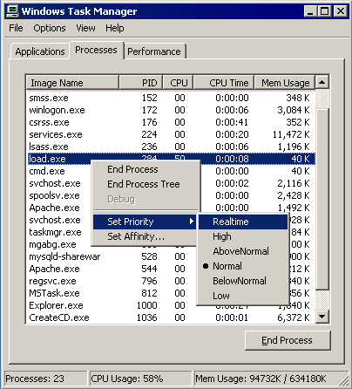
Manual Process Priority Adjustments

Slide 7
Win32 Scheduling-related APIs
Get/SetPriorityClass
Get/SetThreadPriority – relative to its process base priority
Get/SetProcessAffinityMask
SetThreadAffinityMask – must be a subset of the process’s affinity mask
SetThreadIdealProcessor – Establishes a “preferred” processor
Get/SetProcessPriorityBoost
Suspend/ResumeThread

Slide 8
Thread Scheduling
Strictly priority driven
  32 queues (FIFO lists) of ready threads
    One queue for each priority level
    Queues are common to all CPUs
  When thread becomes ready, it:
    either runs immediately, or
    is inserted at the tail end of the Ready queue for its current priority
  On a uniprocessor, highest priority Ready thread always runs
Time-sliced, round-robin within a priority level

Slide 9
Thread Scheduling
Multiprocessor Issues
On a multiprocessor, highest-priority n threads will always run (subject to Affinity, see later)
No attempt is made to share processors “fairly” among processes, only among threads
Tries to keep threads on the same CPU

Slide 10
Scheduling Scenarios
Preemption
  A thread becomes ready at a higher priority than the running thread
    Lower-priority thread is preempted
    Preempted thread goes to the head of its Ready queue
  Strictly event-driven
    Does not wait for the next clock tick
    No guaranteed execution period before preemption

Slide 11
Scheduling Scenarios (2)
Voluntary switch
  When the running thread gives up the CPU
    Waiting on a dispatcher object
    Termination
    Explicit lowering of priority
  Schedule the thread at the head of the next non-empty Ready queue
Running thread experiences quantum end
  Priority is decremented unless at thread base priority
  Thread goes to tail of Ready queue for its new priority
  May continue running if no equal or higher-priority threads are Ready – ie. it “gets” the new quantum

Slide 12
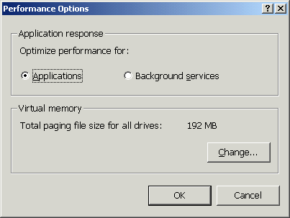
Quantum Details
Standard quantum is two clock ticks
  12 on NT Server
If normal-priority process owns the foreground window, its threads may be given a longer quantum
Windows 2000 has the ability
to choose Workstation
quantums on Server
(and vice versa)

Slide 13
Thread Scheduling States
Init (0) – Thread is “under construction”
Ready (1) – thread eligible to be scheduled to run
Running (2)
Standby (3) – thread is selected to run on CPU
Terminate (4) – thread has executed its last code, but must wait till all references to it are closed
Waiting (5) – wait for one or multiple objects, after a voluntary switch
Transition (6) – thread was in a wait entered from user mode for 12 seconds or more, system was short of physical memory?

Slide 14
Watching the Scheduler
Demo…
CPU Stress and Performance Monitor – both available in Windows 2000 Resource Kit
Trying to show:
  Priority of current thread
  State of current thread

Slide 15
Priority Adjustments
Threads in “dynamic” classes can have priority adjustments applied to them (Boost or Decay)
  Idle, Below Normal, Normal, Above Normal and High
  Carried out upon wait completion
  Used to avoid CPU starvation (see later slide)
No automatic adjustments in “real-time” class
  Priority 16 and above
  Scheduling is therefore “predictable” with respect to ther “real-time” threads
    Note though that this does not mean that there are absolute latency guarantees

Slide 16
Priority Boosting
Priority boost takes place after a wait
  Occurs when a wait (usually I/O) is resolved
    Slow devices / long waits = big boost
    Fast devices / short waits = small boost
  Boost is applied to thread’s base priority
    Does not go over priority 15
  Keeps I/O devices busy
After boost:
  Priority decays one level, followed by another quantum, continuing till at base priority

Slide 17
CPU Starvation
Balance Set Manager looks for “starved” threads
  BSM is a thread running at priority 16, waking up once per second
  Looks at threads that have been Ready for 4 seconds or more
  Boosts up to 10 Ready threads per pass
Special boost applied
  Priority 15
  Quantum is doubled
Does not apply in real-time range

Slide 18
Multiprocessor Support
By default, threads can run on any available processor
Soft affinity (introduced in NT 4.0)
  Every thread has an “ideal processor”
  When thread becomes ready:
    if “ideal” is idle, it runs there
    else, if previous processor is idle, it runs there
    else, may look at next thread, to run on its ideal processor

Slide 19
Multiprocessor Support (2)
Hard affinity
  Restricts thread to a subset of the available CPUs
  Can lead to:
    threads getting less CPU time that they normally would
    Other scheduling anomalies
  Only rarely appropriate

Slide 20
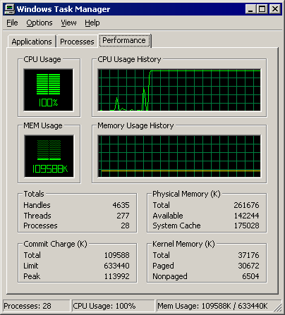
Hard Affinity Example (1)
Single processor, fully loaded

Slide 21
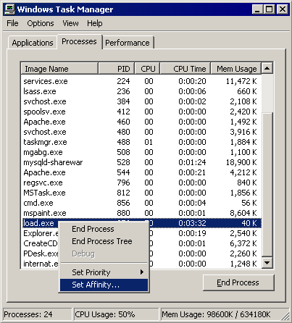
Hard Affinity Example (2)
Set affinity menu

Slide 22
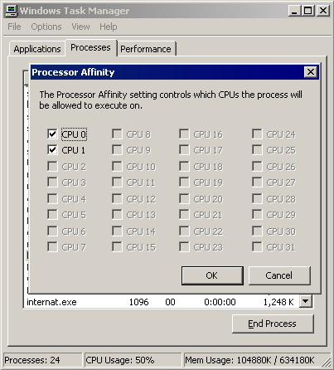
Hard Affinity Example (3)
Affinity setting

Slide 23
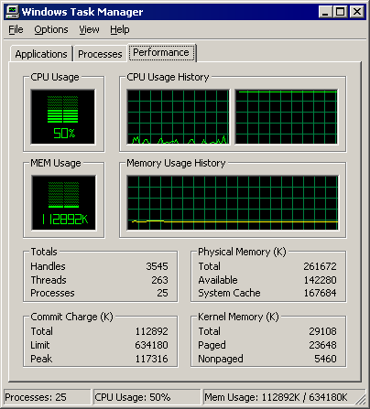
Hard Affinity Example (4)
Hard affinity – one CPU loaded

Slide 24
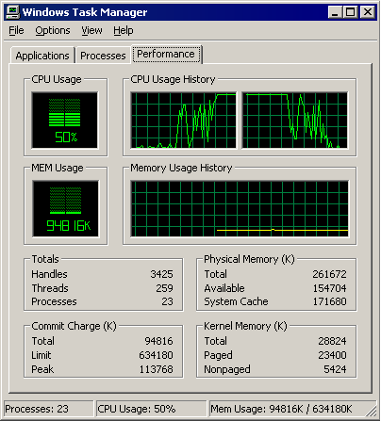
Hard Affinity Example (5)
Affinity effects

Slide 25
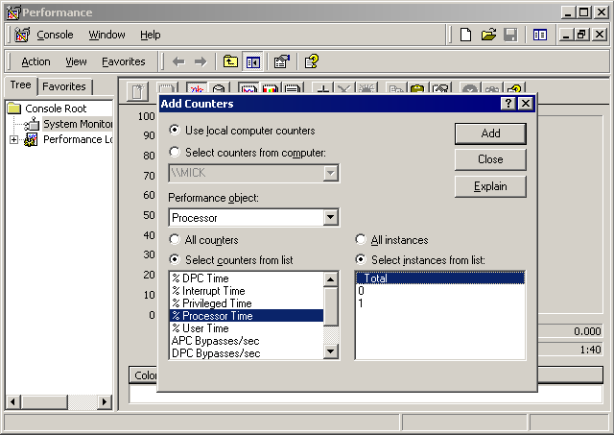
Hard Affinity Example (6)
Adding CPU time using Perfmon

Slide 26
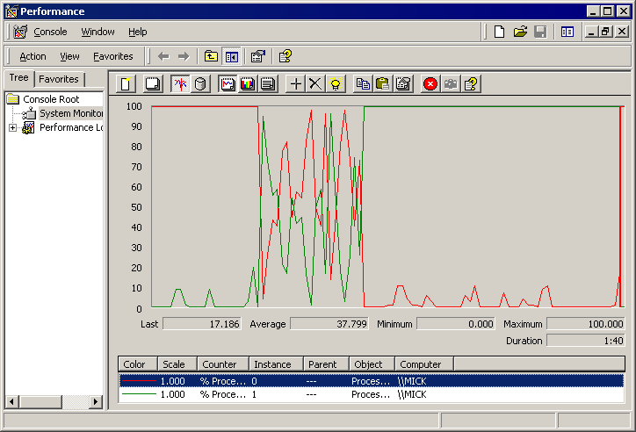
Hard Affinity Example (7)
Perfmon affinity effects

